Slide 1

W E L C O M E
Annual Discussion FY 2025
PRAMOD KOYOTHI
26-01-2025
1

Slide 2
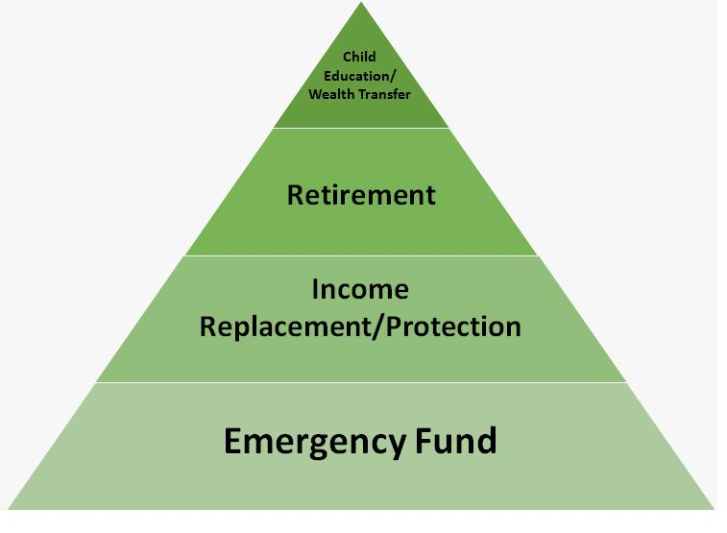
Value Pyramid
In 127 Months
2

Slide 3
Portfolio from 01-04-2023 To 31-03-2024
 | Equity | Hybrid | Debt & Others | Total
Opening Balance : | 59,02,210 |  | 10,02,788 | 69,04,998
Purchase | 19,20,000 | 5,00,000 | 1,79,99,996 | 2,04,19,995
Switch
SwitchOut
divPayout
Redemption | 57,51,121 |  | 70,90,625 | 1,28,41,746
Net Addition : | -38,31,122 | 5,00,000 | 1,09,09,371 | 75,78,249
Closing Balance : | 42,74,769 | 5,66,185 | 1,20,69,128 | 1,69,10,082
Net Gain : | 22,03,681 | 66,185 | 1,56,969 | 24,26,835
XIRR : | 49.87 | 31.90 | 7.49 | 36.56
3

Slide 4
Current Year - YTD
 | Equity | Hybrid | Debt & Others | Total
Opening Balance : | 42,74,769 | 5,66,185 | 1,20,69,128 | 1,69,10,082
Purchase | 16,00,000 |  | 1,90,00,001 | 2,06,00,000
Switch
SwitchOut
divPayout
Redemption |  |  | 3,15,00,040 | 3,15,00,040
Net Addition : | 16,00,000 |  | -1,25,00,039 | -1,09,00,039
Closing Balance : | 63,61,635 | 6,16,277 |  | 69,77,912
Net Gain : | 4,86,866 | 50,092 | 4,30,911 | 9,67,869
XIRR : | 11.78 | 10.85 | 8.05 | 9.71
4

Slide 5
Since Inception
 | Equity | Hybrid | Debt & Others | Total
Opening Balance :
Purchase | 1,41,53,998 | 8,30,000 | 5,30,92,814 | 6,80,76,811
Switch |  |  | 23,80,796 | 23,80,796
SwitchOut | 23,80,819 |  |  | 23,80,819
divPayout
Redemption | 1,32,28,198 | 7,80,451 | 5,67,35,780 | 7,07,44,428
Net Addition : | -14,55,018 | 49,548 | -12,62,170 | -26,67,640
Closing Balance : | 63,61,635 | 6,16,277 |  | 69,77,912
Net Gain : | 78,16,653 | 5,66,729 | 12,62,170 | 96,45,552
XIRR : | 14.86 | 15.49 | 6.78 | 13.05
5

Slide 6
My Journey as on 26-01-2025
6

Slide 7
My Journey as on 26-01-2025
7

Slide 8
Portfolio As On 26-01-2025
Investment value (₹) | Market Value (₹) | Gain | CAGR %
(₹)53,99,999 | (₹)69,77,912 | (₹)15,77,912 | 20.83%
8

Slide 9
Portfolio By Asset Allocation
9

Slide 10
Category Allocation As 26-01-2025
10

Slide 11
Top Stocks
SNo | Name Of The Stock | Allocation % | Amount Rs.
1 | HDFC BANK LIMITED | 3.07% | 2,14,399
2 | ICICI Bank Limited | 2.36% | 1,64,586
3 | Zomato Limited | 1.55% | 1,08,494
4 | Infosys Limited | 1.46% | 1,02,045
5 | Max Healthcare Institute Limited | 1.44% | 1,00,544
6 | DIXON TECHNOLOGIES (INDI LTD | 1.43% | 99,696
7 | TRENT LIMITED | 1.31% | 91,431
8 | Reliance Industries Limited | 1.30% | 90,559
9 | Persistent Systems Limited | 1.26% | 87,872
10 | J K CEMENT LTD | 1.18% | 82,148
 | Total | 16.36% | 11,41,774
11

Slide 12
Top Sectors
12

Slide 13
AMC Allocation
13

Slide 14
Applicants Allocation
SrNo | Applicant Name | Investment value (₹) | Market Value(₹) | CAGR (%) | Allocation (%)
1 | PRAMOD KOYOTHI | 53,99,999 | 69,77,912 | 20.83 | 100.00
 | Total | 53,99,999 | 69,77,912 | 20.83 | 100.00
14

Slide 15
Nominee and Bank Details
SNo | Applicant Name | Folio | Schemes | Bank | A/C No | IFSC | Nominee
1 | PRAMOD KOYOTHI | 2805818/12 | Bandhan Small Cap Fund Reg (G) | HDFC Bank Ltd | xxxxxxxxx03825 | HDFC0000001
2 | PRAMOD KOYOTHI | 18897213/11 | HDFC Large And Mid Cap Fund Reg (G) | HDFC Bank Ltd | xxxxxxxxx03825 | HDFC0000001
3 | PRAMOD KOYOTHI | 25523347 | SBI Retirement Benefit Fund Aggressive Reg (G) | HDFC BANK LTD | xxxxxxxxx03825 | HDFC0000001
4 | PRAMOD KOYOTHI | 4080899/61 | Kotak Smallcap Fund (G) | HDFC Bank Ltd | xxxxxxxxx03825 | HDFC0000001
5 | PRAMOD KOYOTHI | 4080899/61 | Kotak Equity Opportunities Fund (G) | HDFC BANK Ltd | xxxxxxxxx03825 | HDFC0000001
6 | PRAMOD KOYOTHI | 4080899/61 | Kotak Multi Asset Allocation Fund Reg (G) | HDFC BANK LTD | xxxxxxxxx03825 | HDFC0000001
7 | PRAMOD KOYOTHI | 3103865901 | Invesco India Mid Cap Fund (G) | HDFC Bank Ltd | xxxxxxxxx03825 | HDFC0000001
8 | PRAMOD KOYOTHI | 9049351255 | Axis Midcap Fund (G) | HDFC BANK | xxxxxxxxx03825 | HDFC0000001
9 | PRAMOD KOYOTHI | 91011090254 | PGIM India Mid Cap Opp Fund Reg (G) | HDFC Bank Ltd | xxxxxxxxx03825 | HDFC0000001
10 | PRAMOD KOYOTHI | 91011090254 | PGIM India Flexi Cap Fund (G) | HDFC Bank Ltd | xxxxxxxxx03825 | HDFC0000001
15

Slide 16
Current SIP
Particulars | Sum of Amount (₹)
PRAMOD KOYOTHI | ₹ 1,60,000
Axis Midcap Fund (G) | ₹ 10,000
Bandhan Small Cap Fund Reg (G) | ₹ 20,000
HDFC Large And Mid Cap Fund Reg (G) | ₹ 20,000
Invesco India Mid Cap Fund (G) | ₹ 30,000
Kotak Equity Opportunities Fund (G) | ₹ 30,000
Kotak Smallcap Fund (G) | ₹ 15,000
PGIM India Flexi Cap Fund (G) | ₹ 20,000
PGIM India Mid Cap Opp Fund Reg (G) | ₹ 15,000
Grand Total | ₹ 1,60,000
16

Slide 17
Category – Green Schemes
SrNo | Scheme | Investment value (₹) | Market Value(₹) | CAGR (%) | Allocation (%)
1 | Bandhan Small Cap Fund Reg (G) | 5,80,000 | 8,50,522 | 37.40 | 10.74
2 | HDFC Large And Mid Cap Fund Reg (G) | 7,40,000 | 9,92,901 | 21.05 | 13.70
3 | SBI Retirement Benefit Fund Aggressive Reg (G) | 2,00,000 | 3,74,919 | 17.21 | 3.70
4 | Kotak Smallcap Fund (G) | 4,05,001 | 4,86,822 | 17.82 | 7.50
5 | Kotak Equity Opportunities Fund (G) | 7,20,000 | 8,37,453 | 16.37 | 13.33
6 | Kotak Multi Asset Allocation Fund Reg (G) | 5,00,000 | 6,16,277 | 17.92 | 9.26
7 | Invesco India Mid Cap Fund (G) | 8,70,000 | 11,92,628 | 29.92 | 16.11
 | Total | 40,14,999.48 | 53,51,522.39 |  | 74.34
17

Slide 18
Category – Yellow Schemes
SrNo | Scheme | Investment value (₹) | Market Value(₹) | CAGR (%) | Allocation (%)
1 | Axis Midcap Fund (G) | 2,40,000 | 2,85,340 | 18.95 | 4.44
2 | PGIM India Mid Cap Opp Fund Reg (G) | 4,05,000 | 4,63,322 | 12.73 | 7.50
3 | PGIM India Flexi Cap Fund (G) | 7,40,000 | 8,77,727 | 11.73 | 13.70
 | Total | 13,84,999.74 | 16,26,389.14 |  | 25.64
18

Slide 19
Category – Red Schemes
SrNo | Scheme | Investment value (₹) | Market Value(₹) | CAGR (%) | Allocation (%)
 | Total | 0.00 | 0.00 |  | .00
19

Slide 20
Thank You!
20

Slide 21
Disclaimer
Risk factors: Mutual funds, like securities investments, are subject to market and other risks and there can be no assurance that the Schemes' objectives will be achieved. As with any investment in securities, the NAV of Units issued under the Schemes can go up or down depending on the factors and forces affecting capital markets. The NAV of the Schemes' Units may be affected by changes in the general level of interest rates. The past performance of the mutual funds managed by the Sponsors and their affiliates/associates is not necessarily indicative of the future performance of the Schemes. Investors in the Schemes are not being offered a guaranteed or assured rate of return The liquidity of the Scheme's investments may be restricted by trading volumes, settlement periods and transfer procedures. In the event of an inordinately large number of redemption requests or of a restructuring of either of the Scheme's portfolios, the time taken by the Fund for redemption of Units may become significant. Please see 'Risk Factors and Special Considerations' and 'Right to Limit Redemptions' in the Offer Documents. The liquidity & valuation of the Schemes' investments due to its holdings of unlisted securities may be affected if they have to be sold prior to their target da. Consequently, the NAV of the Scheme is linked to the equity performance of such companies and may be more volatile than a more diversified portfolio of equities. Please refer to the Standard Offer Documents of the relevant scheme before investing.
This material is for your private information alone. The information herein has been obtained from various sources and there is no guarantee of its accuracy or completeness. The information or any opinion expressed here is not authorized for use as an offer for sale or a solicitation of an offer to buy Units of the Fund. No part of this material may be copied or duplicated in any form by any, means or redistributed. Investments in Mutual Funds inherently involve risks. Please seek financial advice regarding the appropriateness of investing in any securities or investment strategies discussed or recommended here as statements regarding future prospects may not be realized. Statements and other information herein are as dated and are subject to change.
This communication is confidential and intended solely for the addressee. Any non-addressee must not read, use, disclose or disseminate the same and should inform the sender of its receipt.E-mail is an informal method of communication and is subject to possible data corruption or transmission interference/error.Naik Investment is unable to exercise control over the contents of transmissions via the Internet and hereby excludes any liability for the quality, completeness or accuracy of any such contents and its transmission, reception, storage or reliance or use.We do not guarantee the security of any information electronically transmitted and are not liable for the proper and complete transmission of the information contained in this communication, nor for any delay in -its receipt. The use of email for any illegal purpose or for any purpose other than as permitted by us is strictly prohibited and such use may result in disciplinary and legal action.
21

