Slide 1

W E L C O M E
Annual Discussion FY 2025
MOHIT DHAWAN
27-01-2025
1

Slide 2
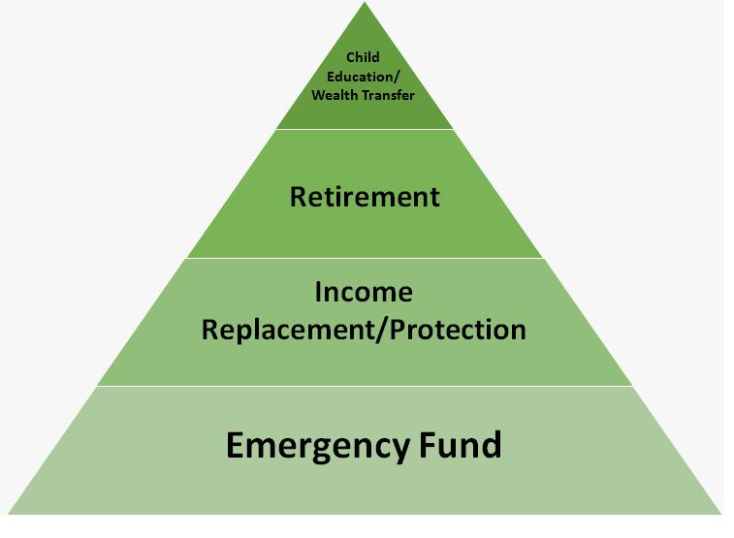
Value Pyramid
In 65 Months
2

Slide 3
Portfolio from 01-04-2023 To 31-03-2024
 | Equity | Hybrid | Debt & Others | Total
Opening Balance :
Purchase | 6,00,000 | 4,00,000 |  | 10,00,000
Switch
SwitchOut
divPayout
Redemption
Net Addition : | 6,00,000 | 4,00,000 |  | 10,00,000
Closing Balance : | 6,21,708 | 4,09,111 |  | 10,30,819
Net Gain : | 21,708 | 9,111 |  | 30,819
XIRR : | 195.23 | 98.70 | 0.00 | 152.14
3

Slide 4
Current Year - YTD
 | Equity | Hybrid | Debt & Others | Total
Opening Balance : | 6,21,708 | 4,09,111 |  | 10,30,819
Purchase | 30,60,001 | 20,40,000 |  | 51,00,001
Switch
SwitchOut
divPayout
Redemption
Net Addition : | 30,60,001 | 20,40,000 |  | 51,00,001
Closing Balance : | 35,73,907 | 24,78,498 |  | 60,52,405
Net Gain : | -1,07,802 | 29,387 |  | -78,415
XIRR : | -4.84 | 2.02 | 0.00 | -2.13
4

Slide 5
Since Inception
 | Equity | Hybrid | Debt & Others | Total
Opening Balance :
Purchase | 36,60,001 | 24,40,000 |  | 61,00,001
Switch
SwitchOut
divPayout
Redemption
Net Addition : | 36,60,001 | 24,40,000 |  | 61,00,001
Closing Balance : | 35,73,907 | 24,78,498 |  | 60,52,405
Net Gain : | -86,094 | 38,498 |  | -47,596
XIRR : | -24.90 | 2.63 | 0.00 | -24.90
5

Slide 6
My Journey as on 27-01-2025
6

Slide 7
My Journey as on 27-01-2025
7

Slide 8
Portfolio As On 27-01-2025
Investment value (₹) | Market Value (₹) | Gain | CAGR %
(₹)61,00,001 | (₹)60,52,405 | (₹)-47,595 | -1.30%
8

Slide 9
Portfolio By Asset Allocation
9

Slide 10
Category Allocation As 27-01-2025
10

Slide 11
Top Stocks
SNo | Name Of The Stock | Allocation % | Amount Rs.
1 | HDFC BANK LIMITED | 5.40% | 3,26,598
2 | ICICI Bank Limited | 3.40% | 2,05,642
3 | Infosys Limited | 2.70% | 1,63,381
4 | Reliance Industries Limited | 2.41% | 1,45,857
5 | STATE BANK OF INDIA | 2.17% | 1,31,625
6 | Axis Bank Limited | 2.12% | 1,28,256
7 | Larsen & Toubro Limited | 1.98% | 1,20,015
8 | Bharti Airtel Limited | 1.67% | 1,01,373
9 | Zomato Limited | 1.26% | 76,082
10 | Sun Pharmaceutical Industries Limited | 1.13% | 68,434
 | Total | 24.24% | 14,67,265
11

Slide 12
Top Sectors
12

Slide 13
AMC Allocation
13

Slide 14
Applicants Allocation
SrNo | Applicant Name | Investment value (₹) | Market Value(₹) | CAGR (%) | Allocation (%)
1 | MOHIT DHAWAN | 61,00,001 | 60,52,405 | -1.30 | 100.00
 | Total | 61,00,001 | 60,52,405 | -1.30 | 100.00
14

Slide 15
Nominee and Bank Details
SNo | Applicant Name | Folio | Schemes | Bank | A/C No | IFSC | Nominee
1 | MOHIT DHAWAN | 27942407/82 | HDFC Large And Mid Cap Fund Reg (G) | IDFC First Bank | xxxxxx98031 | IDFB0040102 | NIKITA DHAWAN
2 | MOHIT DHAWAN | 17761632393 | Canara Robeco Equity Hybrid Fund Reg (G) | IDFC First Bank | xxxxxx98031 | IDFB0040102 | NIKITA DHAWAN
3 | MOHIT DHAWAN | 477326497865 | Nippon India Multi Cap Fund (G) | IDFC First Bank | xxxxxx98031 | IDFB0040102 | NIKITA DHAWAN
4 | MOHIT DHAWAN | 14452815/70 | Kotak Equity Opportunities Fund (G) | IDFC First Bank | xxxxxx98031 | IDFB0040102 | NIKITA DHAWAN
5 | MOHIT DHAWAN | 37555034 | SBI Balanced Advantage Fund Reg (G) | IDFC First Bank | xxxxxx98031 | IDFB0040102 | NIKITA DHAWAN
15

Slide 16
Current SIP
Particulars | Sum of Amount (₹)
MOHIT DHAWAN | ₹ 3,00,000
Canara Robeco Equity Hybrid Fund Reg (G) | ₹ 60,000
HDFC Large And Mid Cap Fund Reg (G) | ₹ 60,000
Kotak Equity Opportunities Fund (G) | ₹ 60,000
Nippon India Multi Cap Fund (G) | ₹ 60,000
SBI Balanced Advantage Fund Reg (G) | ₹ 60,000
Grand Total | ₹ 3,00,000
16

Slide 17
Category – Green Schemes
SrNo | Scheme | Investment value (₹) | Market Value(₹) | CAGR (%) | Allocation (%)
1 | HDFC Large And Mid Cap Fund Reg (G) | 12,20,000 | 11,95,771 | -3.29 | 20.00
2 | Canara Robeco Equity Hybrid Fund Reg (G) | 12,20,000 | 12,29,728 | 1.32 | 20.00
3 | Nippon India Multi Cap Fund (G) | 12,20,001 | 11,86,446 | -4.56 | 20.00
4 | Kotak Equity Opportunities Fund (G) | 12,20,000 | 11,91,690 | -3.85 | 20.00
5 | SBI Balanced Advantage Fund Reg (G) | 12,20,000 | 12,48,770 | 3.97 | 20.00
 | Total | 61,00,000.71 | 60,52,405.23 |  | 100.00
17

Slide 18
Category – Yellow Schemes
SrNo | Scheme | Investment value (₹) | Market Value(₹) | CAGR (%) | Allocation (%)
 | Total | 0.00 | 0.00 |  | .00
18

Slide 19
Category – Red Schemes
SrNo | Scheme | Investment value (₹) | Market Value(₹) | CAGR (%) | Allocation (%)
 | Total | 0.00 | 0.00 |  | .00
19

Slide 20
Thank You!
20

Slide 21
Disclaimer
Risk factors: Mutual funds, like securities investments, are subject to market and other risks and there can be no assurance that the Schemes' objectives will be achieved. As with any investment in securities, the NAV of Units issued under the Schemes can go up or down depending on the factors and forces affecting capital markets. The NAV of the Schemes' Units may be affected by changes in the general level of interest rates. The past performance of the mutual funds managed by the Sponsors and their affiliates/associates is not necessarily indicative of the future performance of the Schemes. Investors in the Schemes are not being offered a guaranteed or assured rate of return The liquidity of the Scheme's investments may be restricted by trading volumes, settlement periods and transfer procedures. In the event of an inordinately large number of redemption requests or of a restructuring of either of the Scheme's portfolios, the time taken by the Fund for redemption of Units may become significant. Please see 'Risk Factors and Special Considerations' and 'Right to Limit Redemptions' in the Offer Documents. The liquidity & valuation of the Schemes' investments due to its holdings of unlisted securities may be affected if they have to be sold prior to their target da. Consequently, the NAV of the Scheme is linked to the equity performance of such companies and may be more volatile than a more diversified portfolio of equities. Please refer to the Standard Offer Documents of the relevant scheme before investing.
This material is for your private information alone. The information herein has been obtained from various sources and there is no guarantee of its accuracy or completeness. The information or any opinion expressed here is not authorized for use as an offer for sale or a solicitation of an offer to buy Units of the Fund. No part of this material may be copied or duplicated in any form by any, means or redistributed. Investments in Mutual Funds inherently involve risks. Please seek financial advice regarding the appropriateness of investing in any securities or investment strategies discussed or recommended here as statements regarding future prospects may not be realized. Statements and other information herein are as dated and are subject to change.
This communication is confidential and intended solely for the addressee. Any non-addressee must not read, use, disclose or disseminate the same and should inform the sender of its receipt.E-mail is an informal method of communication and is subject to possible data corruption or transmission interference/error.Naik Investment is unable to exercise control over the contents of transmissions via the Internet and hereby excludes any liability for the quality, completeness or accuracy of any such contents and its transmission, reception, storage or reliance or use.We do not guarantee the security of any information electronically transmitted and are not liable for the proper and complete transmission of the information contained in this communication, nor for any delay in -its receipt. The use of email for any illegal purpose or for any purpose other than as permitted by us is strictly prohibited and such use may result in disciplinary and legal action.
21

