Slide 1

W E L C O M E
Annual Discussion FY 2025
MILIND VILAS LADE
27-01-2025
1

Slide 2
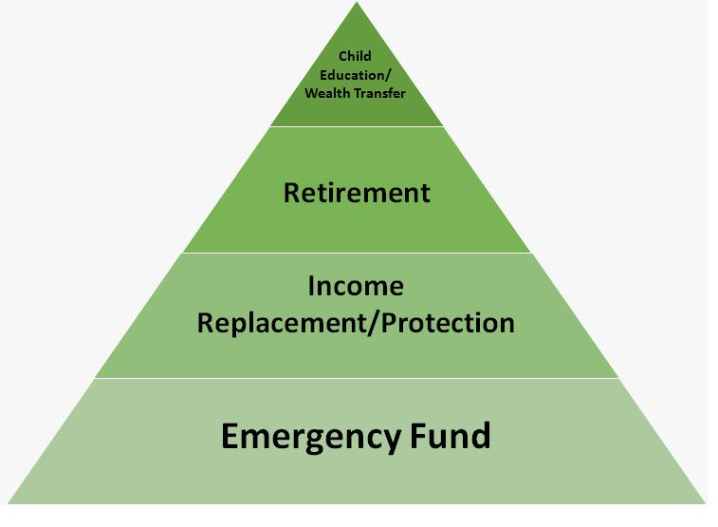
Value Pyramid
In 28 Months
2

Slide 3
Portfolio from 01-04-2023 To 31-03-2024
 | Equity | Hybrid | Debt & Others | Total
Opening Balance :
Purchase
Switch
SwitchOut
divPayout
Redemption
Net Addition :
Closing Balance :
Net Gain :
XIRR : | 0.00 | 0.00 | 0.00 | 0.00
3

Slide 4
Current Year - YTD
 | Equity | Hybrid | Debt & Others | Total
Opening Balance :
Purchase | 17,60,000 | 7,00,000 | 22,50,006 | 47,10,006
Switch | 16,67,208 | 6,04,357 |  | 22,71,565
SwitchOut |  |  | 22,71,563 | 22,71,563
divPayout
Redemption
Net Addition : | 34,27,208 | 13,04,357 | -21,557 | 47,10,008
Closing Balance : | 30,80,167 | 12,55,766 |  | 43,35,933
Net Gain : | -3,47,041 | -48,591 | 21,557 | -3,74,075
XIRR : | -21.05 | -6.85 | 7.27 | -14.19
4

Slide 5
Since Inception
 | Equity | Hybrid | Debt & Others | Total
Opening Balance :
Purchase | 17,60,000 | 7,00,000 | 22,50,006 | 47,10,006
Switch | 16,67,208 | 6,04,357 |  | 22,71,565
SwitchOut |  |  | 22,71,563 | 22,71,563
divPayout
Redemption
Net Addition : | 34,27,208 | 13,04,357 | -21,557 | 47,10,008
Closing Balance : | 30,80,167 | 12,55,766 |  | 43,35,933
Net Gain : | -3,47,041 | -48,591 | 21,557 | -3,74,075
XIRR : | -24.90 | -24.90 | 7.27 | -24.90
5

Slide 6
My Journey as on 27-01-2025
6

Slide 7
My Journey as on 27-01-2025
7

Slide 8
Portfolio As On 27-01-2025
Investment value (₹) | Market Value (₹) | Gain | CAGR %
(₹)47,31,565 | (₹)43,35,932 | (₹)-3,95,633 | -17.57%
8

Slide 9
Portfolio By Asset Allocation
9

Slide 10
Category Allocation As 27-01-2025
10

Slide 11
Top Stocks
SNo | Name Of The Stock | Allocation % | Amount Rs.
1 | HDFC BANK LIMITED | 4.05% | 1,75,420
2 | Infosys Limited | 2.62% | 1,13,386
3 | ICICI Bank Limited | 2.54% | 1,10,285
4 | STATE BANK OF INDIA | 2.02% | 87,559
5 | NTPC Limited | 1.68% | 72,840
6 | Maruti Suzuki India Limited | 1.41% | 61,119
7 | Zomato Limited | 1.32% | 57,340
8 | ITC Limited | 1.31% | 56,788
9 | Axis Bank Limited | 1.31% | 56,714
10 | POWER FINANCE CORPORATION LTD | 1.17% | 50,871
 | Total | 19.43% | 8,42,324
11

Slide 12
Top Sectors
12

Slide 13
AMC Allocation
13

Slide 14
Applicants Allocation
SrNo | Applicant Name | Investment value (₹) | Market Value(₹) | CAGR (%) | Allocation (%)
1 | LADE MADHU MILIND | 10,61,327 | 9,53,746 | -27.52 | 22.43
2 | MILIND VILAS LADE | 36,70,237 | 33,82,185 | -15.48 | 77.57
 | Total | 47,31,565 | 43,35,932 | -17.57 | 100.00
14

Slide 15
Nominee and Bank Details
SNo | Applicant Name | Folio | Schemes | Bank | A/C No | IFSC | Nominee
1 | LADE MADHU MILIND | 14966346/31 | Kotak Multi Asset Allocation Fund Reg (G) | Axis Bank Ltd | xxxxxxxxxx97886 | UTIB0000373 | MILIND VILAS LADE
2 | LADE MADHU MILIND | 34276738 | Franklin India Flexi Cap Fund (G) | Axis Bank Ltd | xxxxxxxxxx97886 | UTIB0000373 | MILIND VILAS LADE
3 | LADE MADHU MILIND | 4738432/54 | Bandhan Small Cap Fund Reg (G) | Axis Bank Ltd | xxxxxxxxxx97886 | UTIB0000373 | MILIND VILAS LADE
4 | LADE MADHU MILIND | 477369722476 | Nippon India Multi Cap Fund (G) | Axis Bank Ltd | xxxxxxxxxx97886 | UTIB0000373 | MILIND VILAS LADE
5 | MILIND VILAS LADE | 14975935/73 | Kotak Multi Asset Allocation Fund Reg (G) | Axis Bank Ltd | xxxxxxxxxx12314 | UTIB0000373 | LADE MADHU MILIND
6 | MILIND VILAS LADE | 477344393124 | Nippon India Multi Cap Fund (G) | Axis Bank Ltd | xxxxxxxxxx12314 | UTIB0000373 | LADE MADHU MILIND
7 | MILIND VILAS LADE | 1001266773 | Mahindra Manulife Mid Cap Fund Reg (G) | Axis Bank Ltd | xxxxxxxxxx12314 | UTIB0000373 | LADE MADHU MILIND
8 | MILIND VILAS LADE | 29910656/16 | HDFC Large And Mid Cap Fund Reg (G) | Axis Bank Ltd | xxxxxxxxxx12314 | UTIB0000373 | LADE MADHU MILIND
9 | MILIND VILAS LADE | 20578924/42 | HSBC Multi Cap Fund Reg (G) | Axis Bank Ltd | xxxxxxxxxx12314 | UTIB0000373 | LADE MADHU MILIND
15

Slide 16
Current SIP
Particulars | Sum of Amount (₹)
MILIND VILAS LADE | ₹ 60,000
HDFC Large And Mid Cap Fund Reg (G) | ₹ 20,000
HSBC Multi Cap Fund Reg (G) | ₹ 20,000
Mahindra Manulife Mid Cap Fund Reg (G) | ₹ 20,000
Grand Total | ₹ 60,000
16

Slide 17
Category – Green Schemes
SrNo | Scheme | Investment value (₹) | Market Value(₹) | CAGR (%) | Allocation (%)
1 | Kotak Multi Asset Allocation Fund Reg (G) | 13,04,357 | 12,55,765 | -6.96 | 27.57
2 | Franklin India Flexi Cap Fund (G) | 3,04,142 | 2,75,617 | -23.73 | 6.43
3 | Bandhan Small Cap Fund Reg (G) | 2,03,925 | 1,74,280 | -47.05 | 4.31
4 | Nippon India Multi Cap Fund (G) | 10,52,325 | 9,42,238 | -21.75 | 22.24
5 | Mahindra Manulife Mid Cap Fund Reg (G) | 5,91,297 | 5,31,796 | -20.82 | 12.50
6 | HDFC Large And Mid Cap Fund Reg (G) | 11,35,519 | 10,30,160 | -19.61 | 24.00
 | Total | 45,91,564.75 | 42,09,855.82 |  | 97.05
17

Slide 18
Category – Yellow Schemes
SrNo | Scheme | Investment value (₹) | Market Value(₹) | CAGR (%) | Allocation (%)
 | Total | 0.00 | 0.00 |  | .00
18

Slide 19
Category – Red Schemes
SrNo | Scheme | Investment value (₹) | Market Value(₹) | CAGR (%) | Allocation (%)
 | Total | 0.00 | 0.00 |  | .00
19

Slide 20
Thank You!
20

Slide 21
Disclaimer
Risk factors: Mutual funds, like securities investments, are subject to market and other risks and there can be no assurance that the Schemes' objectives will be achieved. As with any investment in securities, the NAV of Units issued under the Schemes can go up or down depending on the factors and forces affecting capital markets. The NAV of the Schemes' Units may be affected by changes in the general level of interest rates. The past performance of the mutual funds managed by the Sponsors and their affiliates/associates is not necessarily indicative of the future performance of the Schemes. Investors in the Schemes are not being offered a guaranteed or assured rate of return The liquidity of the Scheme's investments may be restricted by trading volumes, settlement periods and transfer procedures. In the event of an inordinately large number of redemption requests or of a restructuring of either of the Scheme's portfolios, the time taken by the Fund for redemption of Units may become significant. Please see 'Risk Factors and Special Considerations' and 'Right to Limit Redemptions' in the Offer Documents. The liquidity & valuation of the Schemes' investments due to its holdings of unlisted securities may be affected if they have to be sold prior to their target da. Consequently, the NAV of the Scheme is linked to the equity performance of such companies and may be more volatile than a more diversified portfolio of equities. Please refer to the Standard Offer Documents of the relevant scheme before investing.
This material is for your private information alone. The information herein has been obtained from various sources and there is no guarantee of its accuracy or completeness. The information or any opinion expressed here is not authorized for use as an offer for sale or a solicitation of an offer to buy Units of the Fund. No part of this material may be copied or duplicated in any form by any, means or redistributed. Investments in Mutual Funds inherently involve risks. Please seek financial advice regarding the appropriateness of investing in any securities or investment strategies discussed or recommended here as statements regarding future prospects may not be realized. Statements and other information herein are as dated and are subject to change.
This communication is confidential and intended solely for the addressee. Any non-addressee must not read, use, disclose or disseminate the same and should inform the sender of its receipt.E-mail is an informal method of communication and is subject to possible data corruption or transmission interference/error.Naik Investment is unable to exercise control over the contents of transmissions via the Internet and hereby excludes any liability for the quality, completeness or accuracy of any such contents and its transmission, reception, storage or reliance or use.We do not guarantee the security of any information electronically transmitted and are not liable for the proper and complete transmission of the information contained in this communication, nor for any delay in -its receipt. The use of email for any illegal purpose or for any purpose other than as permitted by us is strictly prohibited and such use may result in disciplinary and legal action.
21

