Slide 1

W E L C O M E
Annual Discussion FY 2025
GANESH RAMAKANT DHATRAK
26-01-2025
1

Slide 2
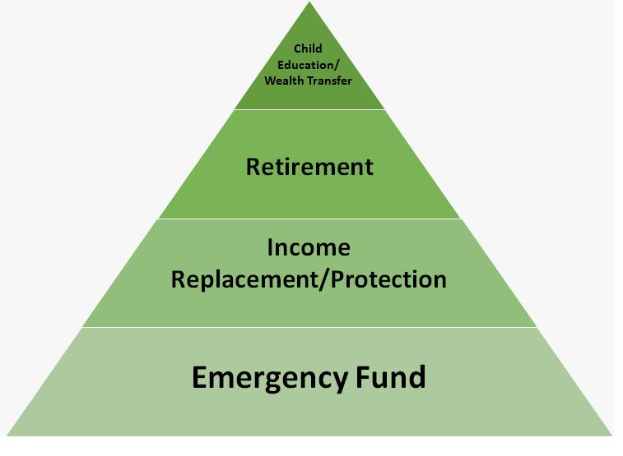
Value Pyramid
In 318 Months
2

Slide 3
Portfolio from 01-04-2023 To 31-03-2024
 | Equity | Hybrid | Debt & Others | Total
Opening Balance : | 52,052 |  | 53,793 | 1,05,845
Purchase | 46,699 |  | 1,51,005 | 1,97,704
Switch
SwitchOut
divPayout
Redemption | 1,650 |  | 2,01,543 | 2,03,193
Net Addition : | 45,050 |  | -50,539 | -5,489
Closing Balance : | 1,25,857 |  | 6,601 | 1,32,458
Net Gain : | 28,755 |  | 3,347 | 32,102
XIRR : | 40.71 | 0.00 | 6.97 | 26.72
3

Slide 4
Current Year - YTD
 | Equity | Hybrid | Debt & Others | Total
Opening Balance : | 1,25,857 |  | 6,601 | 1,32,458
Purchase | 37,000 |  | 1,65,899 | 2,02,899
Switch
SwitchOut
divPayout
Redemption | 22,047 |  | 1,72,537 | 1,94,584
Net Addition : | 14,954 |  | -6,638 | 8,316
Closing Balance : | 1,59,285 |  | 735 | 1,60,020
Net Gain : | 18,474 |  | 772 | 19,246
XIRR : | 16.59 | 0.00 | 7.22 | 15.76
4

Slide 5
Since Inception
 | Equity | Hybrid | Debt & Others | Total
Opening Balance :
Purchase | 3,36,000 | 69,000 | 10,19,912 | 14,24,912
Switch | 5,585 | 19,974 | 21,375 | 46,934
SwitchOut | 21,129 | 4,825 | 5,585 | 31,538
divPayout
Redemption | 2,69,528 | 96,876 | 10,79,783 | 14,46,187
Net Addition : | 50,928 | -12,726 | -44,080 | -5,879
Closing Balance : | 1,59,285 |  | 735 | 1,60,020
Net Gain : | 1,08,357 | 12,726 | 44,815 | 1,65,899
XIRR : | 15.05 | 16.52 | 26.26 | 16.98
5

Slide 6
My Journey as on 26-01-2025
6

Slide 7
My Journey as on 26-01-2025
7

Slide 8
Portfolio As On 26-01-2025
Investment value (₹) | Market Value (₹) | Gain | CAGR %
(₹)1,03,082 | (₹)1,60,019 | (₹)56,937 | 22.60%
8

Slide 9
Portfolio By Asset Allocation
9

Slide 10
Category Allocation As 26-01-2025
10

Slide 11
Top Stocks
SNo | Name Of The Stock | Allocation % | Amount Rs.
1 | HDFC BANK LIMITED | 4.13% | 6,611
2 | ICICI Bank Limited | 2.91% | 4,649
3 | Reliance Industries Limited | 1.61% | 2,577
4 | Tata Consultancy Services Limited | 1.60% | 2,562
5 | Axis Bank Limited | 1.58% | 2,532
6 | Infosys Limited | 1.53% | 2,440
7 | STATE BANK OF INDIA | 1.22% | 1,953
8 | Larsen & Toubro Limited | 1.18% | 1,888
9 | Bharti Airtel Limited | 1.14% | 1,825
10 | LT Foods Limited | 1.02% | 1,631
 | Total | 17.92% | 28,669
11

Slide 12
Top Sectors
12

Slide 13
AMC Allocation
13

Slide 14
Applicants Allocation
SrNo | Applicant Name | Investment value (₹) | Market Value(₹) | CAGR (%) | Allocation (%)
1 | GANESH RAMAKANT DHATRAK | 47,082 | 93,315 | 25.69 | 45.67
2 | PURVI G DHATRAK REP | 56,000 | 66,705 | 12.76 | 54.33
 | Total | 1,03,082 | 1,60,019 | 22.60 | 100.00
14

Slide 15
Nominee and Bank Details
SNo | Applicant Name | Folio | Schemes | Bank | A/C No | IFSC | Nominee
1 | GANESH RAMAKANT DHATRAK | 28474622/57 | ICICI Pru Liquid Fund (G) | SARASWAT COOPERATIVE BANK LIMITED | xxxxxxxxxx63617 | SRCB0000341 | SHEETAL RAMAKANT DHATRAK
2 | GANESH RAMAKANT DHATRAK | 7049707566 | Mirae Asset ELSS Tax Saver Fund Reg (G) | SARASWAT COOPERATIVE BANK LIMITED | xxxxxxxxxx63617 | SRCB0000341 | SHEETAL RAMAKANT DHATRAK
3 | GANESH RAMAKANT DHATRAK | 2842866/30 | Bandhan Small Cap Fund Reg (G) | SARASWAT COOPERATIVE BANK LIMITED | xxxxxxxxxx63617 | SRCB0000341 | SHEETAL RAMAKANT DHATRAK
4 | PURVI GANESH DHATRAK | 9104267243 | PGIM India Flexi Cap Fund (G) | Saraswat Bank | xxxxxxxxxx00436 | SRCB0000341
5 | PURVI GANESH DHATRAK | 22464909/97 | HDFC Large And Mid Cap Fund Reg (G) | SARASWAT COOPERATIVE BANK LIMITED | xxxxxxxxxx00436 | SRCB0000341
15

Slide 16



Goal Summary
₹ 10,44,024
₹ 4,28,424
Target Goal
Current Investments
Purvi Education
Ladakh Trip
Education (Required In 2032)
Vacation (Required In 2025)
Inflated/Target
Current Investments
ShortFall
Inflated/Target
Current Investments
ShortFall
₹9,95,657
₹3,81,890
₹45,59,475
₹48,367
₹46,535
₹1,58,305
Completed (6.87%)
Projected (17.92%)
Shortfall (82.08%)
Completed (22.52%)
Projected (23.40%)
Shortfall (76.60%)
Retirement
Retirement (Required In 2051)
Inflated/Target
Current Investments
ShortFall
₹
₹
₹19,66,49,913
Completed (0.00%)
Projected (0.00%)
Shortfall (100.00%)
16

Slide 17
Current SIP
Particulars | Sum of Amount (₹)
Grand Total | ₹
17

Slide 18
Category – Green Schemes
SrNo | Scheme | Investment value (₹) | Market Value(₹) | CAGR (%) | Allocation (%)
1 | Mirae Asset ELSS Tax Saver Fund Reg (G) | 11,351 | 30,806 | 15.02 | 11.01
2 | Bandhan Small Cap Fund Reg (G) | 35,000 | 61,774 | 39.44 | 33.95
3 | HDFC Large And Mid Cap Fund Reg (G) | 39,000 | 42,705 | 11.46 | 37.83
 | Total | 85,350.73 | 1,35,284.68 |  | 82.79
18

Slide 19
Category – Yellow Schemes
SrNo | Scheme | Investment value (₹) | Market Value(₹) | CAGR (%) | Allocation (%)
1 | ICICI Pru Liquid Fund (G) | 731 | 735 | 6.68 | 0.71
2 | PGIM India Flexi Cap Fund (G) | 17,000 | 24,000 | 12.64 | 16.49
 | Total | 17,731.42 | 24,734.70 |  | 17.20
19

Slide 20
Category – Red Schemes
SrNo | Scheme | Investment value (₹) | Market Value(₹) | CAGR (%) | Allocation (%)
 | Total | 0.00 | 0.00 |  | .00
20

Slide 21
Thank You!
21

Slide 22
Disclaimer
Risk factors: Mutual funds, like securities investments, are subject to market and other risks and there can be no assurance that the Schemes' objectives will be achieved. As with any investment in securities, the NAV of Units issued under the Schemes can go up or down depending on the factors and forces affecting capital markets. The NAV of the Schemes' Units may be affected by changes in the general level of interest rates. The past performance of the mutual funds managed by the Sponsors and their affiliates/associates is not necessarily indicative of the future performance of the Schemes. Investors in the Schemes are not being offered a guaranteed or assured rate of return The liquidity of the Scheme's investments may be restricted by trading volumes, settlement periods and transfer procedures. In the event of an inordinately large number of redemption requests or of a restructuring of either of the Scheme's portfolios, the time taken by the Fund for redemption of Units may become significant. Please see 'Risk Factors and Special Considerations' and 'Right to Limit Redemptions' in the Offer Documents. The liquidity & valuation of the Schemes' investments due to its holdings of unlisted securities may be affected if they have to be sold prior to their target da. Consequently, the NAV of the Scheme is linked to the equity performance of such companies and may be more volatile than a more diversified portfolio of equities. Please refer to the Standard Offer Documents of the relevant scheme before investing.
This material is for your private information alone. The information herein has been obtained from various sources and there is no guarantee of its accuracy or completeness. The information or any opinion expressed here is not authorized for use as an offer for sale or a solicitation of an offer to buy Units of the Fund. No part of this material may be copied or duplicated in any form by any, means or redistributed. Investments in Mutual Funds inherently involve risks. Please seek financial advice regarding the appropriateness of investing in any securities or investment strategies discussed or recommended here as statements regarding future prospects may not be realized. Statements and other information herein are as dated and are subject to change.
This communication is confidential and intended solely for the addressee. Any non-addressee must not read, use, disclose or disseminate the same and should inform the sender of its receipt.E-mail is an informal method of communication and is subject to possible data corruption or transmission interference/error.Naik Investment is unable to exercise control over the contents of transmissions via the Internet and hereby excludes any liability for the quality, completeness or accuracy of any such contents and its transmission, reception, storage or reliance or use.We do not guarantee the security of any information electronically transmitted and are not liable for the proper and complete transmission of the information contained in this communication, nor for any delay in -its receipt. The use of email for any illegal purpose or for any purpose other than as permitted by us is strictly prohibited and such use may result in disciplinary and legal action.
22

